Slide 1

What Course AI
By kyle kelly

Slide 2

Index
Introduction
Business case/Model
User description/goals
Application overview
Application features

Slide 3
Introduction
This project's goal is to create a mobile application that will help students better manage and comprehend the courses that are offered to them. The app can also enable course comparison for the students. What topics are addressed in each course, and which one delivers the best results. accessing the course.
Students will be able to use this program to explore and pinpoint the best classes to fulfil their academic and professional goals. Choosing the best course might be difficult considering the wide range of options provided by various universities and professions.

Slide 4
Business case
There is a growing need for customized, approachable, and technologically advanced solutions that can assist students in navigating the challenging world of academic and professional options as the education industry continues to develop.
An app that may simplify the course discovery process and make it more accessible to students from all backgrounds is increasingly needed as more students than ever before consider higher education. In this business case, we suggest creating a course application that would give students a way to look up, contrast, and select classes that matched their interests and aspirations

Slide 5
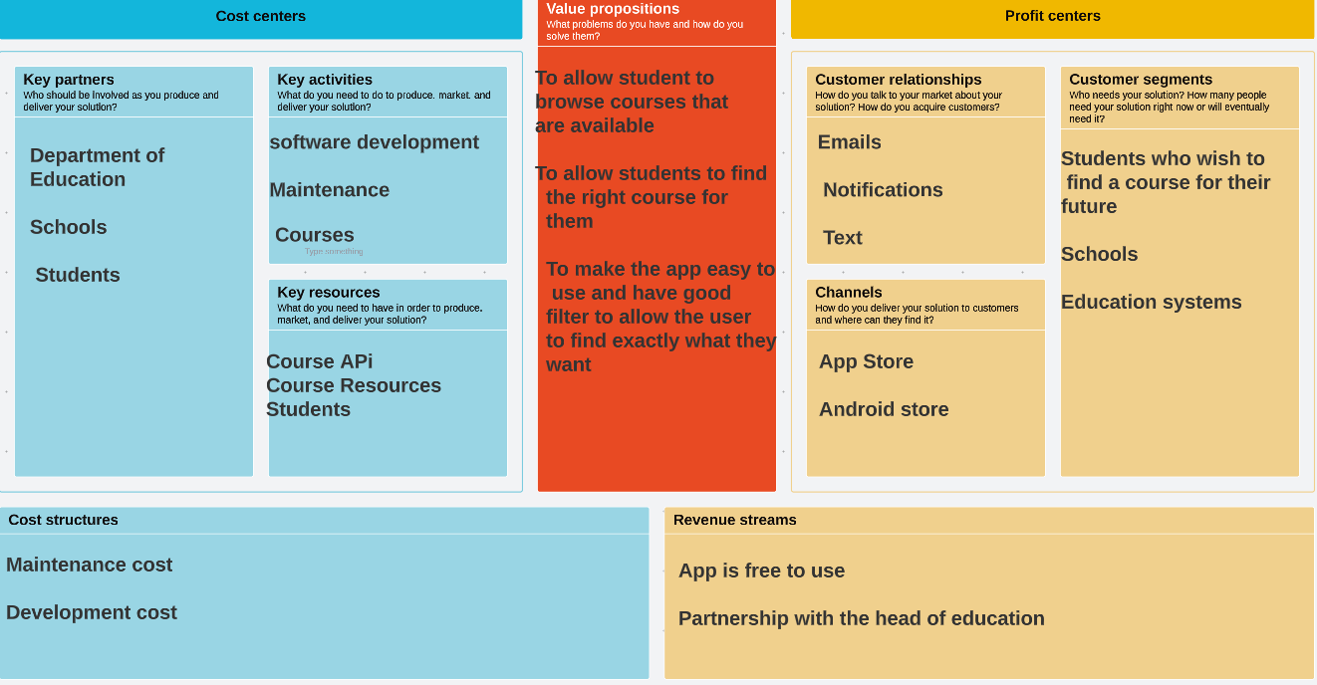
Business Model

Slide 6
User Goals
To easily browse through all available courses, sorted by department or subject matter.
To view detailed information about each course, such as the course description, prerequisites, and schedule.
To compare courses side-by-side to determine which courses fit best with their academic goals and schedule.
To receive personalized recommendations for courses based on their academic history and interests.
To track their progress towards fulfilling degree requirements and academic goals.

Slide 7
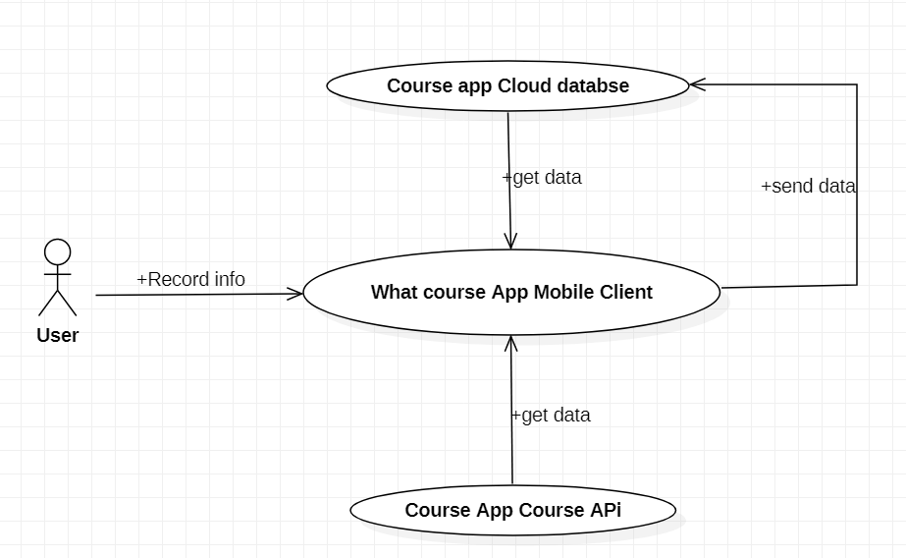
Application Overview
Application that aids students in browsing and investigating the many courses offered at their college. Students can browse for courses using the application's user-friendly design, filter them based on different criteria, and examine specific details about each course.

Slide 8
Application Features
Course Search: The program has a search field where users can type in terms associated with a particular course they are interested in. Students can limit the search results based on a variety of criteria, including department, level, and credit hours. The search results are presented according to relevancy.
Information about each course, including its description, grade, schedule, and instructors, is displayed in full by the application. To have a better understanding of the course, students can also read evaluations and ratings left by former participants.
Course Comparison: Using the tool, students may compare several courses side by side, making it simpler for them to see how the courses differ and how they are similar.
In order to use all of the capabilities of the application, students must first register an account. Students' accounts allow them to save preferences, view search histories, and access wish lists.

Slide 9
